Slide 1
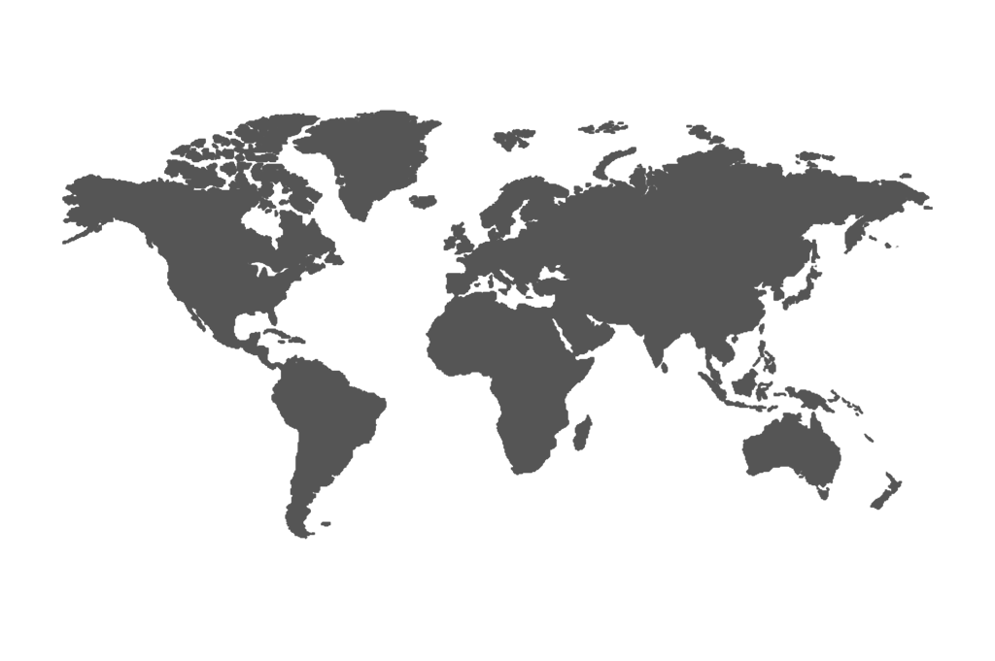
Data Exploration & Business Insights with SQL (Northwind Database)
RAJU KUMAR

Slide 2

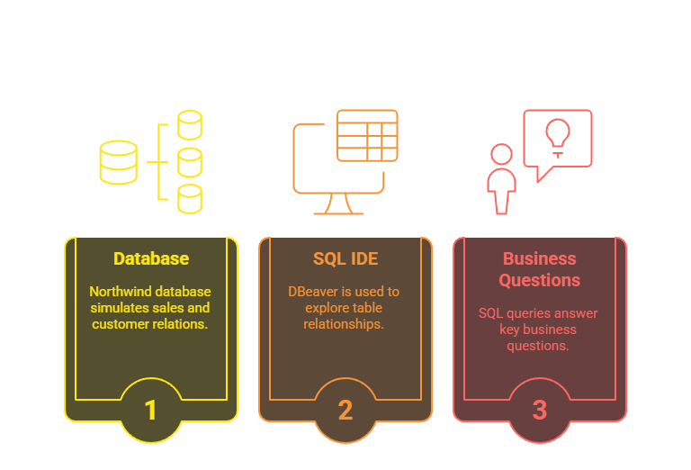

Project Introduction
RAJU KUMAR

Slide 3
Database Schema Overview
RAJU KUMAR
The schema includes core entities such as:
salesorder, orderdetail, customer, product, employee, supplier, etc.
Tables are linked via primary and foreign keys to maintain data integrity.
This logical structure allows us to perform complex joins, aggregations, and filters to generate business reports.
Purpose: Data querying, filtering, aggregation, and visualization (if required)

Slide 4
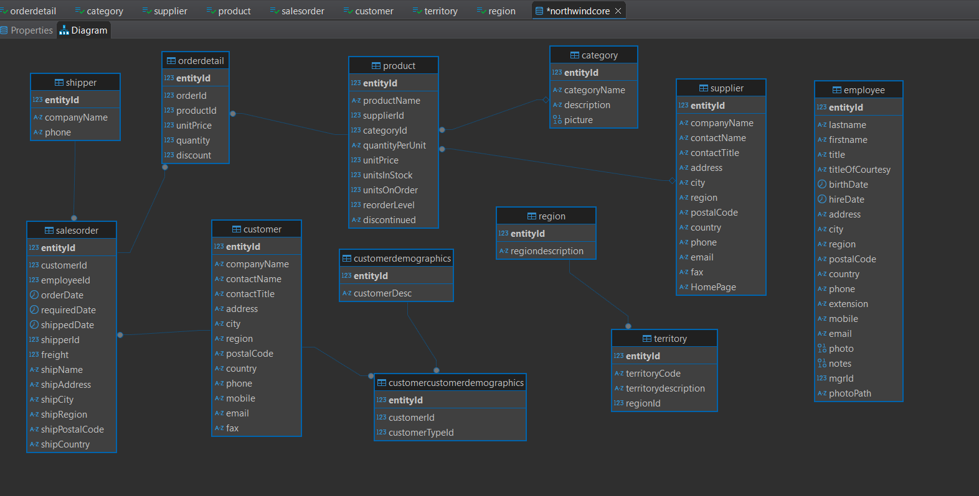
🧩 Relational Database Structure
RAJU KUMAR

Slide 5
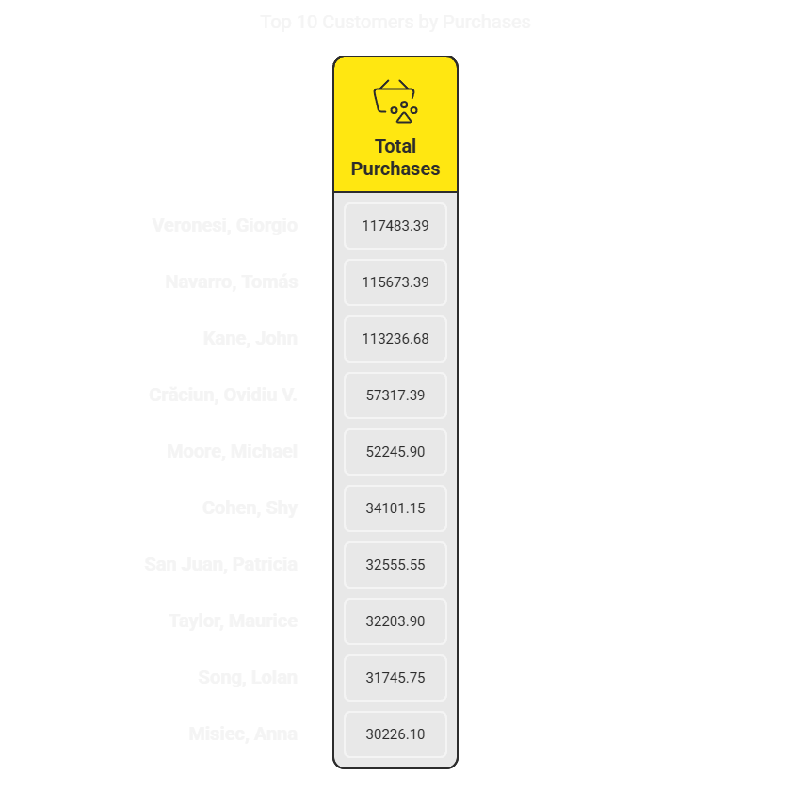
-- Who are the top 10 customers based on total purchases?
SELECT C.CONTACTNAME , SUM(O.UNITPRICE * O.QUANTITY) as total_purchases
from
NORTHWINDCORE.CUSTOMER C
join
NORTHWINDCORE.SALESORDER S on C.ENTITYID = S.CUSTOMERID
join
NORTHWINDCORE.ORDERDETAIL O on S.ENTITYID = O.ORDERID
GROUP BY C.ENTITYID
ORDER BY total_purchases DESC
limit 10;
RAJU KUMAR

Slide 6
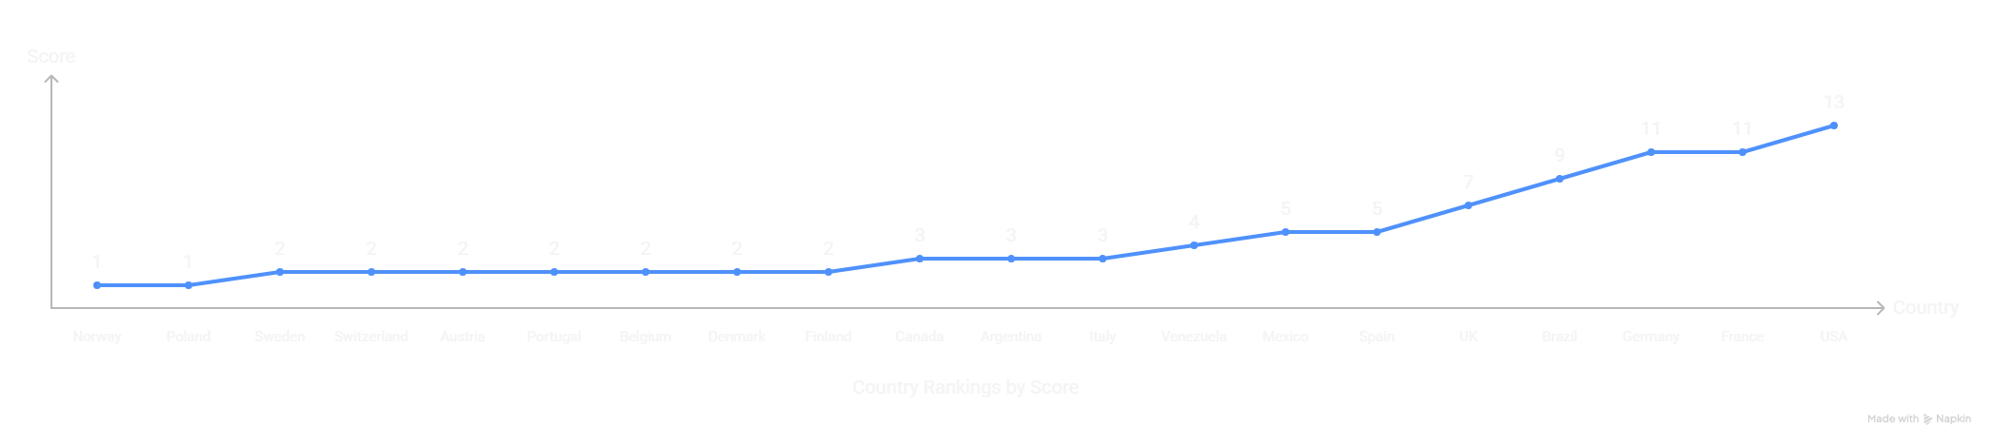
-- What is the total number of customers in each country?
SELECT COUNTRY , Count(*) as Total_customers from
NORTHWINDCORE.CUSTOMER C
group by COUNTRY
ORDER BY Total_customers ;
RAJU KUMAR

Slide 7
-- What is the most common customer type (Customer Type ID)?
SELECT CUSTOMERID , COUNT(*) as customer_count
from
NORTHWINDCORE.SALESORDER S
group by CUSTOMERID
order by customer_count desc ;
RAJU KUMAR

Slide 8
-- Which customers have the highest discount applied to their orders?
SELECT C.CONTACTNAME , Max(O.DISCOUNT) as highest_discount
from
NORTHWINDCORE.ORDERDETAIL O
join
NORTHWINDCORE.CUSTOMER C
on C.ENTITYID = O.ENTITYID
group by C.CONTACTNAME
ORDER by highest_discount desc ;
with DiscountRank as (
select C.CONTACTNAME , O.DISCOUNT ,
DENSE_RANK () over( order by O.DISCOUNT desc ) as ranke
from NORTHWINDCORE.ORDERDETAIL O
join NORTHWINDCORE.CUSTOMER C
on O.ENTITYID = C.ENTITYID
)
select * from DiscountRank
order by DISCOUNT desc ;
RAJU KUMAR

Slide 9
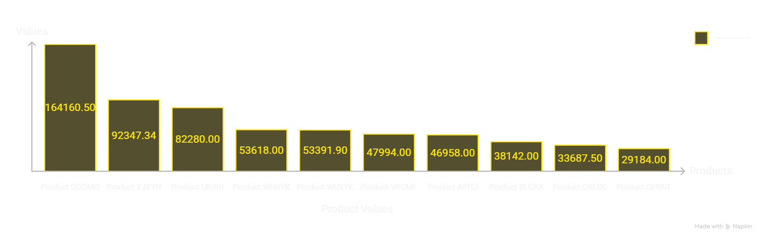
-- Which products have the highest sales?
SELECT
P.PRODUCTNAME,
SUM(O.QUANTITY * P.UNITPRICE) AS TOTAL_SALES
FROM NORTHWINDCORE.PRODUCT P
JOIN NORTHWINDCORE.ORDERDETAIL O
ON P.ENTITYID = O.PRODUCTID
GROUP BY P.PRODUCTNAME
ORDER BY TOTAL_SALES desc
limit 10 ;
RAJU KUMAR

Slide 10
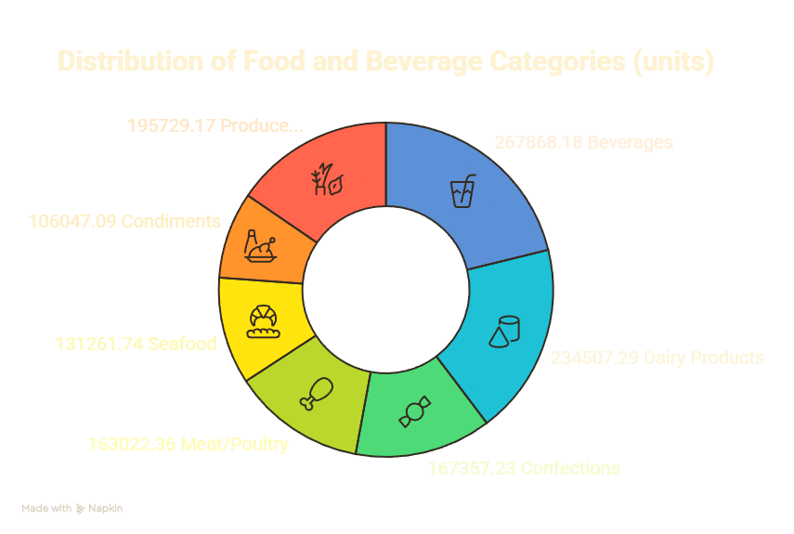
-- What is the total revenue generated by each product category?
select C.CATEGORYNAME ,
SUM(O.UNITPRICE * O.QUANTITY * (1-O.discount) ) as total_revenue
from NORTHWINDCORE.CATEGORY C
join
NORTHWINDCORE.PRODUCT P on P.CATEGORYID = C.ENTITYID
join
NORTHWINDCORE.ORDERDETAIL O on O.PRODUCTID = p.ENTITYID
group by c.CATEGORYNAME
order by total_revenue desc ;
RAJU KUMAR

Slide 11
-- Which product has the lowest stock available?
select PRODUCTNAME ,UNITSINSTOCK from
NORTHWINDCORE.PRODUCT P
order by UNITSINSTOCK ;
RAJU KUMAR

Slide 12
-- Which supplier provides the most products?
select companyName , COUNT(*) as ProductSupply from
NORTHWINDCORE.SUPPLIER S
join
NORTHWINDCORE.PRODUCT P
on P.SUPPLIERID = S.ENTITYID
GROUP by S.companyName
order by ProductSupply desc
limit 1 ;
RAJU KUMAR

Slide 13
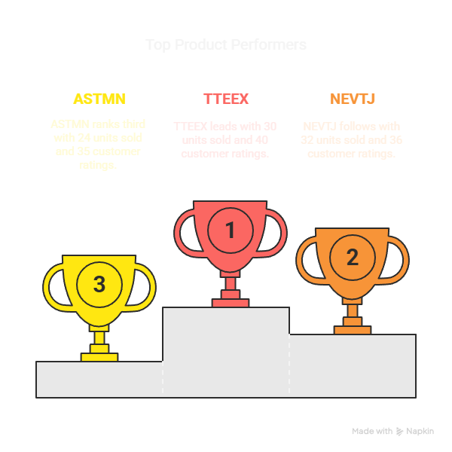
-- What is the reorder level for each product, and which ones need restocking?
SELECT productName, UNITSINSTOCK, reorderLevel
FROM NORTHWINDCORE.PRODUCT
WHERE UNITSINSTOCK <= reorderLevel
ORDER BY UNITSINSTOCK;
RAJU KUMAR

Slide 14
-- Which employees have processed the most orders?
SELECT CONCAT(E.FIRSTNAME, ' ', E.LASTNAME) AS EmployeeName , EMPLOYEEID , count(*) as processedOder
from NORTHWINDCORE.SALESORDER S
join NORTHWINDCORE.EMPLOYEE E on
E.ENTITYID = S.EMPLOYEEID
group by EMPLOYEEID
order by processedOder desc
limit 1 ;
RAJU KUMAR

Slide 15
-- What is the average number of orders handled per employee?
RAJU KUMAR
WITH EmployeeOrders AS (
SELECT EMPLOYEEID, COUNT(*) AS OrderCount
FROM NORTHWINDCORE.SALESORDER
GROUP BY EMPLOYEEID
)
SELECT AVG(OrderCount) AS AvgOrdersPerEmployee FROM EmployeeOrders;
92.2222

Slide 16
-- Which employee has been with the company the longest (based on hire date)?
RAJU KUMAR
SELECT *, ROUND(DATEDIFF(NOW(), HIREDATE) / 365 , 0 ) AS YearsSinceHired
FROM NORTHWINDCORE.EMPLOYEE
order by YearsSinceHired desc
limit 1 ;

Slide 17
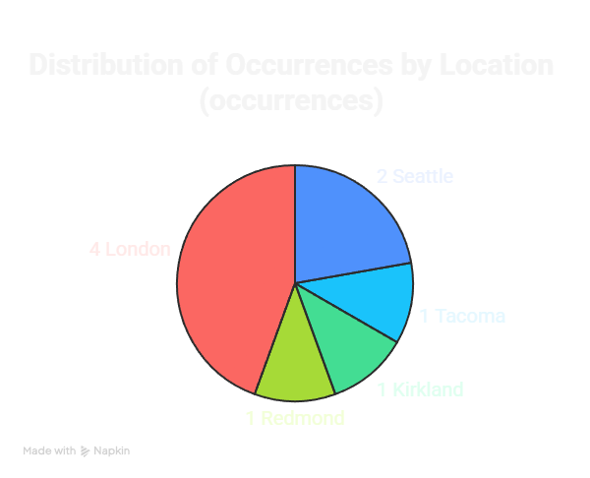
-- What is the distribution of employees by region or city?
RAJU KUMAR
select
CITY ,COUNT(*) as distributionOfEmployees
from NORTHWINDCORE.EMPLOYEE E
group by CITY ;

Slide 18
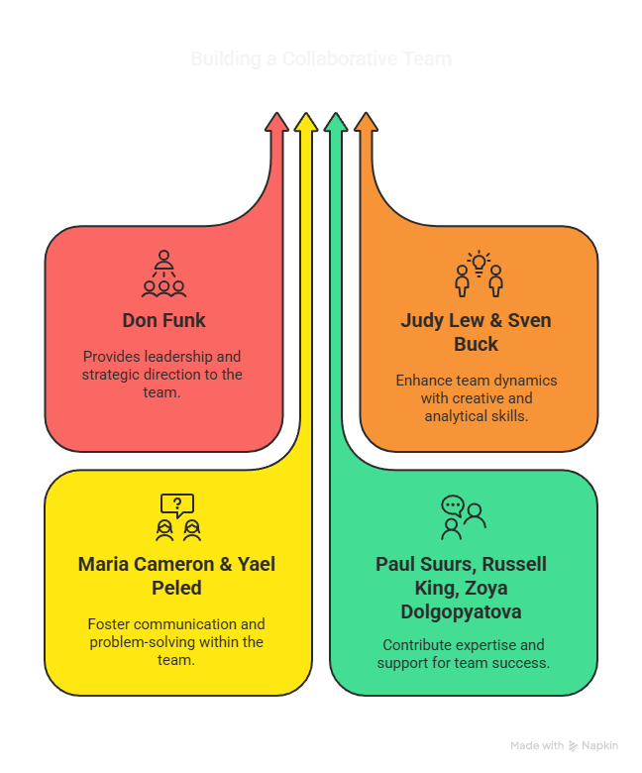
-- Which employees have the same manager (Mgr ID)?
RAJU KUMAR
SELECT MGRID ,
GROUP_CONCAT(CONCAT(FIRSTNAME, ' ', LASTNAME) ORDER BY FIRSTNAME SEPARATOR ', ') AS Employees
FROM NORTHWINDCORE.EMPLOYEE
WHERE MGRID IS NOT NULL
GROUP BY MGRID ;

Slide 19
-- Which shipping company (Shipper) is used the most?
RAJU KUMAR
select S2.COMPANYNAME , count(*) as Shipper from
NORTHWINDCORE.SALESORDER S
join NORTHWINDCORE.SHIPPER S2
on S.SHIPPERID = S2.ENTITYID
group by S2.ENTITYID
order by Shipper desc
limit 1 ;

Slide 20
-- What is the average shipping time from order date to required date?
RAJU KUMAR
select ROUND( AVG( DATEDIFF( S.REQUIREDDATE , S.ORDERDATE ) ) ,0 ) as average_shipping
from NORTHWINDCORE.SALESORDER S ;
28

Slide 21
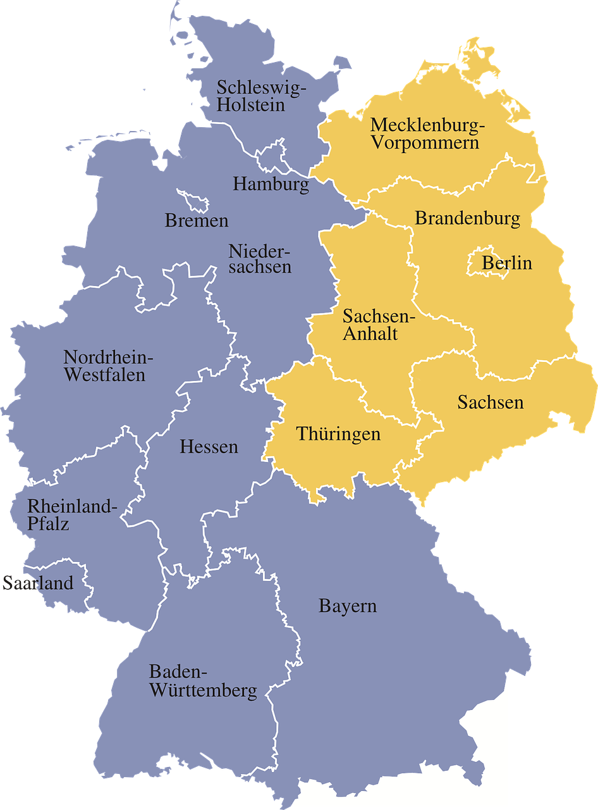
-- Which country receives the most shipments?
RAJU KUMAR
select S.SHIPCOUNTRY , count(*) as OrderCount from
NORTHWINDCORE.SALESORDER S
group by S.SHIPCOUNTRY
order by OrderCount desc
limit 1 ;

Slide 22
-- Which regions have the most delayed shipments (shippedDate vs requiredDate)?
RAJU KUMAR
SELECT S.SHIPREGION, MAX(DATEDIFF(S.REQUIREDDATE, S.ORDERDATE)) AS MaxDateDiff
FROM NORTHWINDCORE.SALESORDER S
GROUP BY S.SHIPREGION
ORDER BY MaxDateDiff desc
limit 1 ;

Slide 23
-- What is the average freight cost per order?
RAJU KUMAR
SELECT ROUND( AVG(S.FREIGHT),2) as average_freight_cost
from NORTHWINDCORE.SALESORDER S ;

Slide 24
-- Which supplier provides the highest number of products?
SELECT SUPPLIER_COUNT,
GROUP_CONCAT(COMPANYNAME ORDER BY COMPANYNAME SEPARATOR ', ') AS SUPPLIERS
FROM (
SELECT S.COMPANYNAME,
COUNT(P.PRODUCTNAME) AS SUPPLIER_COUNT
FROM NORTHWINDCORE.PRODUCT P
JOIN NORTHWINDCORE.SUPPLIER S
ON P.SUPPLIERID = S.ENTITYID
GROUP BY S.COMPANYNAME
) AS SupplierCounts
GROUP BY SUPPLIER_COUNT
ORDER BY SUPPLIER_COUNT DESC;
RAJU KUMAR
select s.COMPANYNAME ,
COUNT(PRODUCTNAME) as PRODUCTCOUNT
from NORTHWINDCORE.PRODUCT P
join NORTHWINDCORE.SUPPLIER S
on P.SUPPLIERID = S.ENTITYID
GROUP by S.ENTITYID
order by PRODUCTCOUNT desc
limit 1 ;

Slide 25
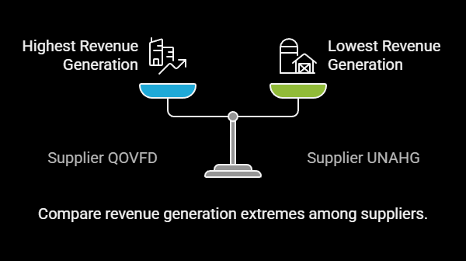
-- What is the total revenue generated by each supplier’s products?
RAJU KUMAR
select S.COMPANYNAME , SUM(P.UNITPRICE * P.UNITSINSTOCK) as TOTAL_REVENUE
from NORTHWINDCORE.PRODUCT P
join NORTHWINDCORE.SUPPLIER S
on P.SUPPLIERID = S.ENTITYID
GROUP by S.COMPANYNAME ;

Slide 26
-- Which supplier has the most out-of-stock products?
SELECT S.COMPANYNAME,
COUNT(*) AS OUT_OF_STOCK
FROM NORTHWINDCORE.PRODUCT P
JOIN NORTHWINDCORE.SUPPLIER S
ON S.ENTITYID = P.SUPPLIERID
WHERE P.UNITSINSTOCK = 0
GROUP BY S.COMPANYNAME
ORDER BY OUT_OF_STOCK DESC
LIMIT 1;
SELECT S.COMPANYNAME , sum( P.UNITSINSTOCK ) as out_of_stock
FROM
NORTHWINDCORE.PRODUCT P
join NORTHWINDCORE.SUPPLIER S
on S.ENTITYID = P.SUPPLIERID
GROUP by P.SUPPLIERID
order by out_of_stock asc
limit 1 ;
RAJU KUMAR

Slide 27
-- Which supplier operates in the most regions?
RAJU KUMAR
SELECT S.REGION,
COUNT(DISTINCT S.ENTITYID) AS OUT_OF_STOCK
FROM NORTHWINDCORE.PRODUCT P
JOIN NORTHWINDCORE.SUPPLIER S
ON S.ENTITYID = P.SUPPLIERID
GROUP BY S.REGION
limit 1 ;

Slide 28
-- Which suppliers have the highest-reorder Level products ?
RAJU KUMAR
SELECT S.COMPANYNAME , sum(P.REORDERLEVEL) as reorder_Level
from
NORTHWINDCORE.PRODUCT P
join NORTHWINDCORE.SUPPLIER S
ON S.ENTITYID = P.SUPPLIERID
GROUP by S.COMPANYNAME
order by reorder_Level desc
limit 1 ;

Slide 29
-- Which month has the highest number of orders?
SELECT
MONTH(S.ORDERDATE) AS orderMonth,
MAX(DATE_FORMAT(S.ORDERDATE, '%M')) AS monthName,
SUM(O.QUANTITY) AS totalQuantity
FROM NORTHWINDCORE.SALESORDER S
JOIN NORTHWINDCORE.ORDERDETAIL O
ON O.ORDERID = S.ENTITYID
GROUP BY orderMonth
ORDER BY totalQuantity desc
limit 1 ;
RAJU KUMAR

Slide 30
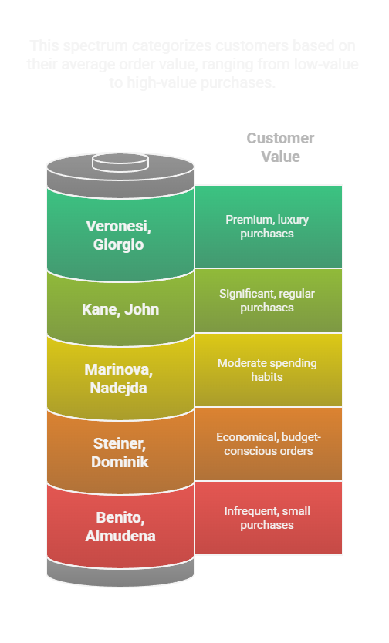
-- What is the average order value per customer?
select C.ENTITYID , C.CONTACTNAME ,
round(Avg(O.UNITPRICE *O.QUANTITY * (1- O.DISCOUNT) ) , 2)as OrderValue
from NORTHWINDCORE.SALESORDER S
join NORTHWINDCORE.CUSTOMER C
on S.CUSTOMERID = C.ENTITYID
join NORTHWINDCORE.ORDERDETAIL O
on O.ORDERID = S.ENTITYID
group by C.ENTITYID
order by OrderValue desc;
RAJU KUMAR

Slide 31
-- How many orders are placed in each region?
select S.SHIPREGION , count(*)
from NORTHWINDCORE.SALESORDER S
GROUP by S.SHIPREGION;
RAJU KUMAR

Slide 32
-- What is the most frequently ordered product?
select P.PRODUCTNAME , Count(O.ORDERID) as OderCount
from NORTHWINDCORE.ORDERDETAIL O
join NORTHWINDCORE.PRODUCT P
on O.PRODUCTID = P.ENTITYID
group by P.ENTITYID
order by ODERCOUNT desc
limit 1 ;
RAJU KUMAR

Slide 33
-- Which suppliers have the highest-reorder Level products ?
SELECT S.COMPANYNAME , sum(P.REORDERLEVEL) as reorder_Level
from
NORTHWINDCORE.PRODUCT P
join NORTHWINDCORE.SUPPLIER S
ON S.ENTITYID = P.SUPPLIERID
GROUP by S.COMPANYNAME
order by reorder_Level desc
limit 1 ;
RAJU KUMAR

Slide 34
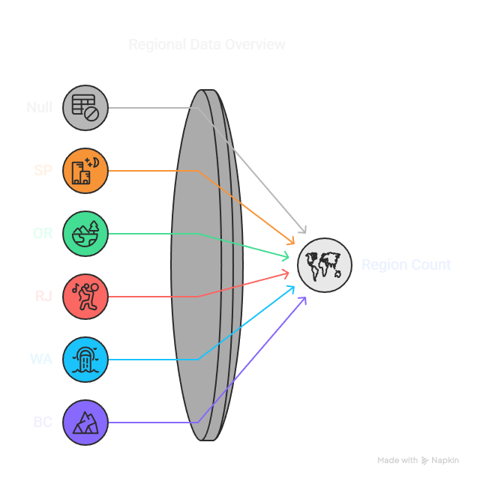
-- What are the most common shipping regions?
select C.REGION , count(*)
from NORTHWINDCORE.CUSTOMER C
group by C.REGION
order by count(*) desc;
RAJU KUMAR

Slide 35
-- Which products are out of stock?
SELECT P.PRODUCTNAME
FROM NORTHWINDCORE.PRODUCT P
WHERE P.UNITSINSTOCK = 0
UNION
SELECT 'No product is out of stock'
WHERE NOT EXISTS (
SELECT 1
FROM NORTHWINDCORE.PRODUCT
WHERE UNITSINSTOCK = 0
);
SELECT
CASE
WHEN COUNT(*) = 0 THEN 'No product is out of stock'
ELSE GROUP_CONCAT(PRODUCTNAME)
END AS Result
FROM NORTHWINDCORE.PRODUCT
WHERE UNITSINSTOCK = 0;
RAJU KUMAR

Slide 36
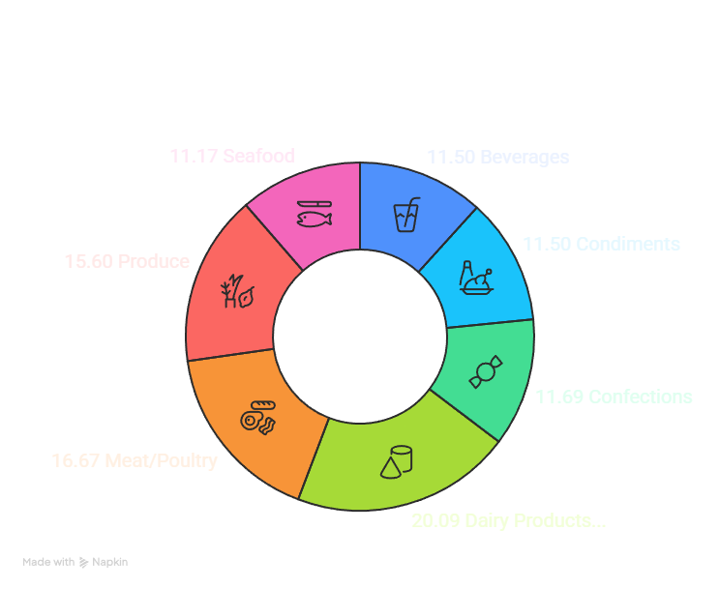
-- What is the average quantity per unit for each category?
SELECT
C.CATEGORYNAME,
AVG(CAST(SUBSTRING_INDEX(P.QUANTITYPERUNIT, ' ', 1) AS UNSIGNED)) AS AVG_QUANTITY_PER_UNIT
FROM
NORTHWINDCORE.CATEGORY C
JOIN
NORTHWINDCORE.PRODUCT P
ON
C.ENTITYID = P.CATEGORYID
WHERE
P.QUANTITYPERUNIT IS NOT NULL
GROUP BY
C.CATEGORYNAME;
RAJU KUMAR

Slide 37
-- Which products have the highest unit price?
select *
from NORTHWINDCORE.PRODUCT P
where
P.UNITPRICE = (
select max(X.UNITPRICE) from NORTHWINDCORE.PRODUCT X
) ;
RAJU KUMAR

Slide 38
-- Which regions have the highest demand for stock replenishment?
SELECT
S.REGION,
SUM(P.UNITSINSTOCK ) AS TOTAL_UNITS_IN_STOCK,
SUM(P.UNITSONORDER ) AS TOTAL_UNITS_ON_ORDER,
(SUM(P.UNITSONORDER) - SUM(P.UNITSINSTOCK)) AS STOCK_DEMAND
FROM
NORTHWINDCORE.PRODUCT P
JOIN
NORTHWINDCORE.SUPPLIER S
ON
P.SUPPLIERID = S.ENTITYID
GROUP BY
S.REGION
ORDER BY
STOCK_DEMAND DESC;
RAJU KUMAR

Slide 39
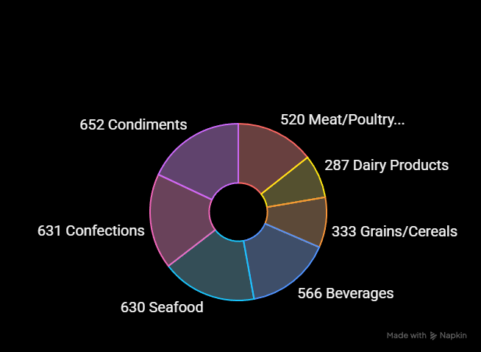
-- Which product categories are running low on inventory?
select C.CATEGORYNAME , sum(P.UNITSINSTOCK) lowinventory
from
NORTHWINDCORE.PRODUCT P
join NORTHWINDCORE.CATEGORY C
on P.CATEGORYID = C.ENTITYID
group by C.CATEGORYNAME
order by lowinventory ;
RAJU KUMAR

Slide 40
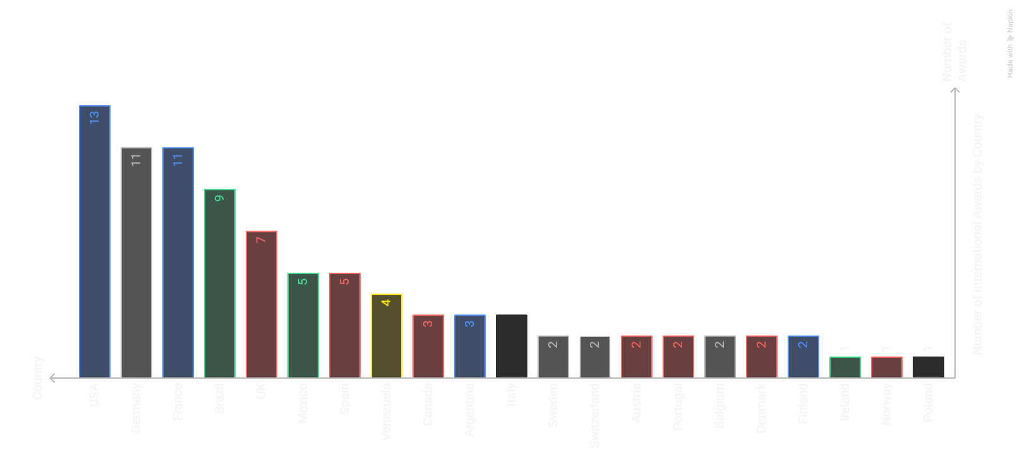
-- What is the distribution of customers by country?
select C.COUNTRY , count(*) distribution
from NORTHWINDCORE.CUSTOMER C
group by C.COUNTRY
order by distribution desc;
RAJU KUMAR

Slide 41
-- What is the average number of orders per customer?
SELECT AVG(ORDER_COUNT) AS AVG_ORDERS_PER_CUSTOMER
FROM (
SELECT
C.ENTITYID,
COUNT(S.ENTITYID) AS ORDER_COUNT
FROM
NORTHWINDCORE.SALESORDER S
JOIN
NORTHWINDCORE.CUSTOMER C
ON
C.ENTITYID = S.CUSTOMERID
GROUP BY
C.ENTITYID
) AS CUSTOMER_ORDERS;
RAJU KUMAR

Slide 42
-- Which customers place repeat orders the most?
select C.COMPANYNAME, count(S.ENTITYID) as ORDER_COUNT
from NORTHWINDCORE.SALESORDER S
join
NORTHWINDCORE.CUSTOMER C
on
S.CUSTOMERID = C.ENTITYID
group by C.ENTITYID
HAVING ORDER_COUNT >1
ORDER BY ORDER_COUNT DESC;
RAJU KUMAR

Slide 43
-- What percentage of customers use mobile contact instead of landline?
SELECT
ROUND(
(COUNT(CASE WHEN MOBILE IS NOT NULL AND (PHONE IS NULL OR PHONE = '') THEN 1 END)
/ COUNT(*)) * 100, 2
) AS PERCENTAGE_MOBILE_ONLY
FROM
NORTHWINDCORE.CUSTOMER;
RAJU KUMAR

Slide 44
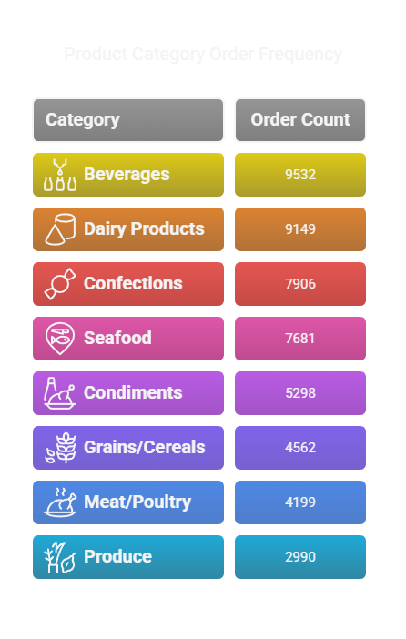
-- What is the most frequently ordered product category?
SELECT
C.CATEGORYNAME,
SUM(O.QUANTITY) AS TOTAL_QUANTITY_ORDERED
FROM
NORTHWINDCORE.ORDERDETAIL O
JOIN
NORTHWINDCORE.PRODUCT P ON O.PRODUCTID = P.ENTITYID
JOIN
NORTHWINDCORE.CATEGORY C ON C.ENTITYID = P.CATEGORYID
GROUP BY
C.CATEGORYNAME
ORDER BY
TOTAL_QUANTITY_ORDERED DESC
LIMIT 1;
RAJU KUMAR

Slide 45
-- Which region generates the most revenue ?
SELECT
S.SHIPREGION,
SUM(O.UNITPRICE * O.QUANTITY * (1 - O.DISCOUNT)) AS TOTAL_REVENUE
FROM
NORTHWINDCORE.SALESORDER S
JOIN
NORTHWINDCORE.ORDERDETAIL O ON S.ENTITYID = O.ORDERID
GROUP BY
S.SHIPREGION
ORDER BY
TOTAL_REVENUE DESC
LIMIT 1;
RAJU KUMAR

Slide 46
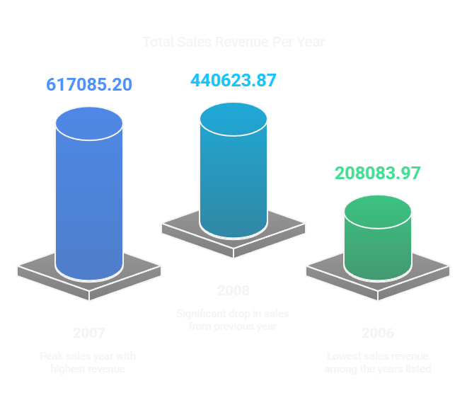
-- What is the total sales revenue per year?
SELECT
Year(S.ORDERDATE) as Year_AS ,
round(SUM(O.UNITPRICE * O.QUANTITY * (1 - O.DISCOUNT)) ,2 )
AS TOTAL_REVENUE
FROM
NORTHWINDCORE.SALESORDER S
JOIN
NORTHWINDCORE.ORDERDETAIL O ON S.ENTITYID = O.ORDERID
GROUP BY
Year(S.ORDERDATE)
ORDER BY
TOTAL_REVENUE DESC ;
RAJU KUMAR

Slide 47
-- What is the growth trend in order volume over the years?
SELECT
YEAR(S.ORDERDATE) AS YEAR_AS,
COUNT(S.ENTITYID) AS TOTAL_ORDERS,
LAG(COUNT(S.ENTITYID), 1) OVER (ORDER BY YEAR(S.ORDERDATE)) AS PREVIOUS_YEAR_ORDERS,
ROUND(
( (COUNT(S.ENTITYID) - LAG(COUNT(S.ENTITYID), 1) OVER (ORDER BY YEAR(S.ORDERDATE)))
/ NULLIF(LAG(COUNT(S.ENTITYID), 1) OVER (ORDER BY YEAR(S.ORDERDATE)), 0) ) * 100, 2
) AS GROWTH_PERCENTAGE
FROM
NORTHWINDCORE.SALESORDER S
GROUP BY
YEAR(S.ORDERDATE)
ORDER BY
YEAR_AS;
RAJU KUMAR

Slide 48

RAJU KUMAR

